Slide 1
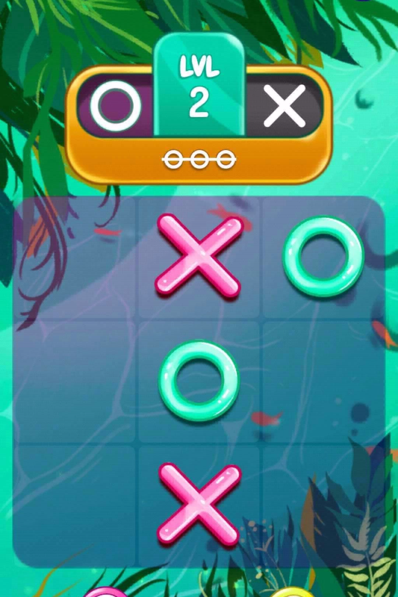
Tic Tac Toe Project with Android Studio
Join me on a journey to create a classic game of Tic Tac Toe using Java and Android Studio.
by Arjun Bansal

Slide 2
Tic Tac Toe: The All-time Favorite
History
Rules
Strategy
Believed to date back to ancient Rome, Tic Tac Toe is still relevant and popular today, providing endless hours of entertainment.
Played on a 3x3 grid, players take turns marking their symbol (either X or O). The player who gets three of their symbols in a row wins.
Although seemingly simple, Tic Tac Toe requires strategic thinking to win or draw, making it a great game for all ages.

Slide 3
Setting up Your Development Environment
1
Installing the Java Development Kit
Java is the programming language used for Android app development. Download and install the JDK on your computer.
Setting up Android Studio
2
Android Studio is the primary tool for Android app development. Download and install the latest version on your computer.
3
Configuring the Android Virtual Device
Create a virtual device using the AVD Manager in Android Studio to run and test your application.

Slide 4
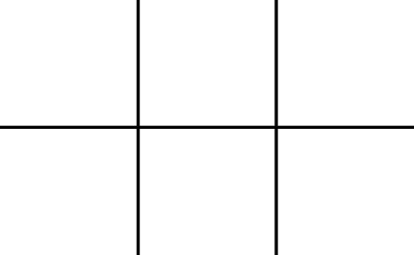
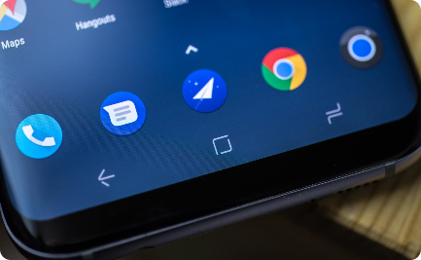
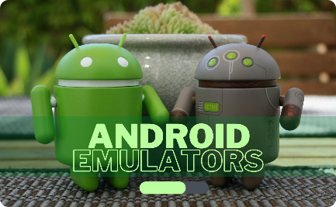
Creating the User Interface
Designing the Layout of the Game Board
Implementing Buttons and Click Event Handlers
Dynamically Updating the Game Board Display
Use XML to design the 3x3 grid and positioning the game pieces on the board.
Add buttons for each cell on the board to allow players to choose a position for their moves. Add event listeners to handle the click event.
Use Java code to dynamically update the display of the game board as players make their moves.

Slide 5

Implementing the Game Logic
1
Creating the Tic Tac Toe Game Class
Create a Java class for the Tic Tac Toe game, which will manage the game state and determine the winner.
2
Implementing Methods for Checking Win Conditions
Write Java methods for checking vertical, horizontal, and diagonal win conditions as players make their moves.
3
Handling Player Turns and Updating the Game State
Use Java code to alternate between player turns and update the game state after each move.

Slide 6

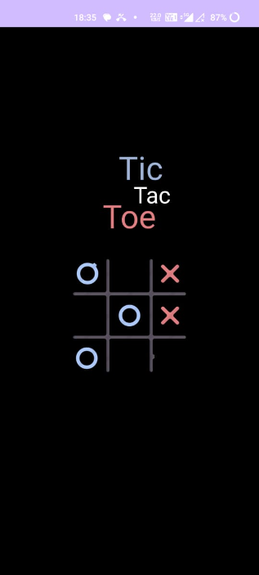
Splash Screen
A splash screen in a Tic Tac Toe game serves as an engaging introduction for players before they delve into the main gameplay. It's a graphical element that provides a visually appealing welcome, often containing the game title, graphics, or any other information that sets the tone for the gaming experience.

Slide 7
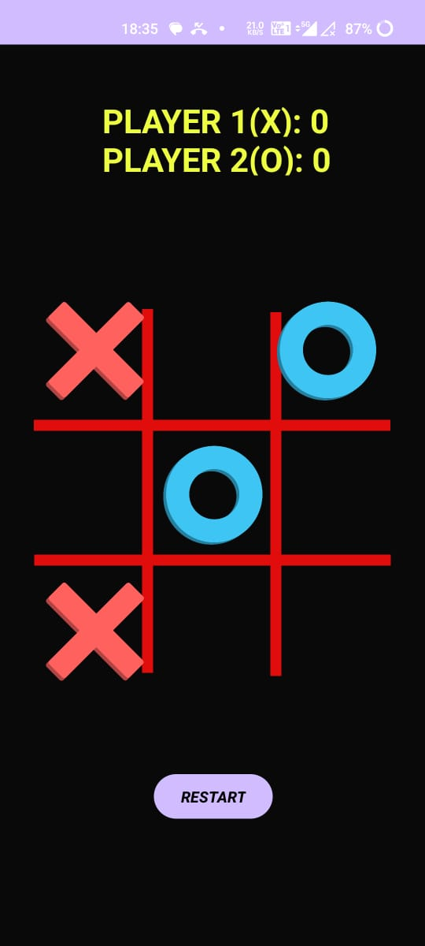
Home Screen
Home Screen
Game Board:
3x3 grid for player moves (X or O).
Scoreboard:
Tracks wins, losses, or ties for multiple rounds.
Reset/Restart Button:
Initiates a new round or clears the board.
Outcome Display:
Shows game result (win, tie) after each move

Slide 8
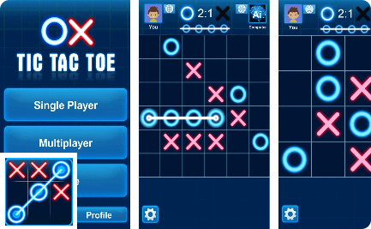
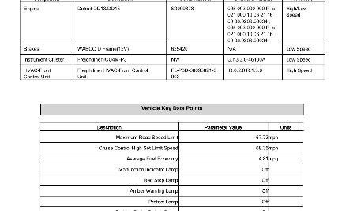

Testing and Debugging
Running the Game on the Emulator
Testing for Different Scenarios
Identifying and Fixing Issues and Errors
Test the game on the Android emulator or an actual device to check if it performs as expected.
Test various scenarios, such as winning and losing, making invalid moves, etc., and document your results.
Use debugging techniques to identify and resolve issues and errors in your code until the game runs smoothly.

Slide 9
Conclusion
1
Summary of the Project
2
Reflection on the Experience and Lessons Learned
3
Possible Future Enhancements or Extensions
We have learned how to create a classic game of Tic Tac Toe using Java and Android Studio.
We gained experience with Java programming and Android app development and learned the importance of iterative testing and debugging.
We can add more features to the game, such as an AI player, player scores, or multiplayer capabilities.

